Slide 1
Apps for SAP Project and Portfolio Management
Milliarum App: PPM capacity analyses

Slide 2
About Milliarum
• We focus our consulting and development on system solutions for SAP Project Management since the company was founded in 2006
• Our solutions are based on the SAP® Project System and SAP® EPPM
• Our focus is on Project Management, Product Development, customised production and resource management processes
• The aim of our solutions is to create efficient, cost-effective and therefore competitive business processes for our customers
• With the Milliarum Cockpit (MC) and its content packages, as well as the Milliarum Apps we have standardised software products that "close the gaps" in SAP's standard software for Project Management.

Slide 3
Overview of Milliarum Apps
• Standardised UI5 or Web Dynpro apps "for quick usage„
• "Modern" and simple User Interface
• Can be used immediately due to preconfigured scope of delivery
• Access via Fiori Launchpad/SAP Business Client/URL
• Runs with PPM 6.1/ERP EHP8 and SAP_UI 7.54 or higher and for all S/4HANA releases
• Delivery as transport
• Language versions: German and English
• Licence model with maintenance/support (17% annually)
• Customised expansion options
• Interface customisation as part of the SAP infrastructure (SAP UI5 flexibility, Web Dynpro configuration)
• Marketing/Sales via Milliarum website (Apps area)
• Ticket system for customer reports via Mantis

Slide 4
Milliarum WebDynpro Apps: General conditions
• Delivery via transport requests (development/customising) based on separate Scenarios/Roles in the Milliarum Cockpit
• Single call as "SingleService" by entering the project number
• Instructions for embedding the App in the PPM project dashboard
• Customising environment for defining the app
• Prerequisite: at least PPM 6.1 or S/4HANA EPPM 1.0
• Licensing via User with a maintenance contract

Slide 5
Apps for EPPM Projects - App PPM Capacity Analyses
Functional scope
• Predefined capacity analyses based on SAP® Web Dynpro Abap and Business Graphics with customer-specific evaluations via customising
• Analyses: Utilisation by PPM Project Type, PPM Project Cause and PPM Projects
• Available capacities and hierarchies are determined from SAP organisation management
• Evaluation along the organisational structure possible
• Performance-optimised evaluations via "shared memory" with online data update
Requirements
• SAP Organisation Management with Business Partners/Persons
• Additional field Organisational unit to PPM Role
Benefits
• Utilisation charts for complete organisational units and higher-level summarisation levels

Slide 6
Overall Resource Management process (with SAP PPM Project and Milliarum PPM Staffing Overview)
PPM Resources (optional HCM integration) and Organisation management/ Work centres/ Resource pools)
1
Available capacity
Project ( Project Management)
Cost centre ( Resource Management)
Demand planning and adjustment
Staff scheduling
- PL/Resource Manager checks the requirements and schedules the Employees/Resources
- Allocation according to Roles / Tasks
Project management reports requirement for role "Engineering" from May to June with a budget of 300 hours
Ms. Schulz and Mr. Meier assigned to the notified requirements for the "Engineering " role
2
3
Checking hours for adjustment the requirements planning
Time recording and approval
- The project management carries out plausibility checks at" Role/Task level“
- Conspicuous issues are resolved in dialogue
- Ms. Schulz and Mr. Meier report their hours
- PL/Resource Manager approves these
5
4
PPM Project Capacity Analyses and Milliarum Capacity Analyses)
6
Evaluation/Simulation

Slide 7
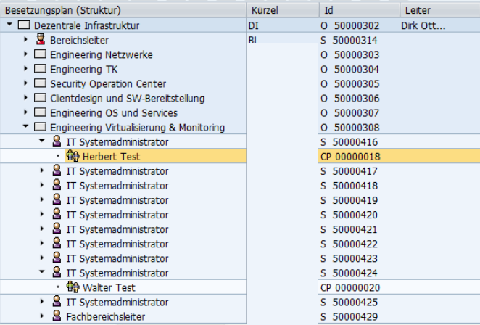
Capacity available via Organisational Unit
Planning of available capacities via Organisational Units and the assigned business partners
The available capacities are determined from the employees' planned working hours minus absences

Slide 8
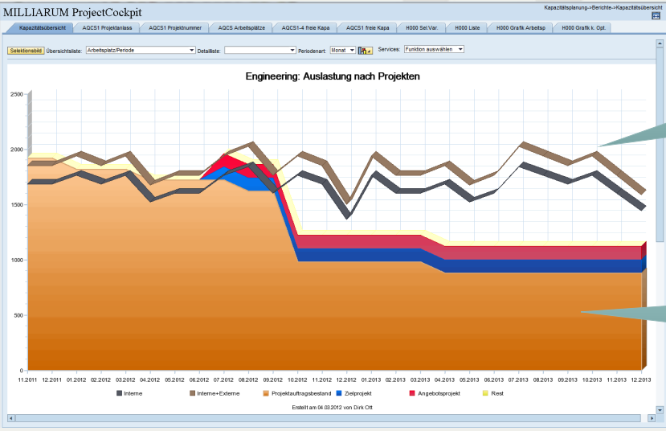
Milliarum Content Package "Capacity evaluation"
Comparison of capacity requirements from projects and available capacity according to internal and external resources (example Plant Engineering)
1. Internal/
External offer
2. Requirements from Project

Slide 9
Capacity evaluation: IT project example
Capacity utilisation by Project type

Slide 10
Capacity evaluation: Example of plant construction (Project types)

Slide 11
Capacity evaluation: Example of plant construction (Single project)

Slide 12
Evaluations of Organisational structure

Slide 13
Contact & Sales
We are happy to answer your questions or provide you a non-binding offer directly. Use our licence calculator at www.milliarum.de under Apps or send us the following data to info@milliarum.com:
• Desired edition
• Number of users and developer licences
• SAP release and SAP UI version used
You will receive a software contract from us including maintenance and support.
After signed contract and receipt of payment, the software will be delivered by transport.
Milliarum GmbH & Co.KG
An der Eickesmühle 22
41238 Mönchengladbach
Tel.: +49 (0) 2166 3101 106
www.milliarum.de

