Slide 1
Apps for SAP Project and Portfolio Management
Milliarum App: PPM Task processing (appointments)

Slide 2
About Milliarum
• We focus our consulting and development on system solutions for SAP Project Management since the company was founded in 2006
• Our solutions are based on the SAP® Project System and SAP® EPPM
• Our focus is on Project Management, Product Development, customised production and resource management processes
• The aim of our solutions is to create efficient, cost-effective and therefore competitive business processes for our customers
• With the Milliarum Cockpit (MC) and its content packages, as well as the Milliarum Apps we have standardised software products that "close the gaps" in SAP's standard software for Project Management.

Slide 3
Overview of Milliarum Apps
• Standardised UI5 or Web Dynpro apps "for quick usage„
• "Modern" and simple User Interface
• Can be used immediately due to preconfigured scope of delivery
• Access via Fiori Launchpad/SAP Business Client/URL
• Runs with PPM 6.1/ERP EHP8 and SAP_UI 7.54 or higher and for all S/4HANA releases
• Delivery as transport
• Language versions: German and English
• Licence model with maintenance/support (17% annually)
• Customised expansion options
• Interface customisation as part of the SAP infrastructure (SAP UI5 flexibility, Web Dynpro configuration)
• Marketing/Sales via Milliarum website (Apps area)
• Ticket system for customer reports via Mantis

Slide 4
Milliarum WebDynpro Apps: General conditions
• Delivery via transport requests (development/customising) based on separate Scenarios/Roles in the Milliarum Cockpit
• Single call as "SingleService" by entering the project number
• Instructions for embedding the App in the PPM project dashboard
• Customising environment for defining the app
• Prerequisite: at least PPM 6.1 or S/4HANA EPPM 1.0 Licensing via User with a maintenance contract

Slide 5
Apps for EPPM Projects - Task processing (appointments)
Functional scope
• Calling up project in edit mode
• Tabular editing of task data
• Quick entry into arrangement relationships
• Quick entry into tasks
Requirements
• Tasks below the phases
Benefits
• Significantly faster processing than in the SAP Standard, especially for entering relationships

Slide 6
App Task Processing I: Basic Data
5. Filter
3. Actions such as Create, Delete, Edit
1. Overview screen of all tasks in the Project
2. Input fields (Name, Date period, Work)

Slide 7
App Task Processing II: Dates
5. Back
6. Filter
4. Call up the Task Relationship overview
1. Overview of all task data in the Project
2. Overview of Dates
3. Field for input Constraint

Slide 8
App Task Processing III : Relationships
4. Next creates relationships of the type "Normal sequence" in the Project
2. "Virtual" numbering for each task
3. Input of Predecessor and Successor with "virtual" number
1. Overview screen of all tasks and relationships in the Project

Slide 9
App Task Processing IV: Relationships Details
5. Back to "Tasks Relationships"
4. Next saves the project
3. Edit Relationship Type
2. Selection of the Calendar
1. Processing the time intervals between the tasks

Slide 10
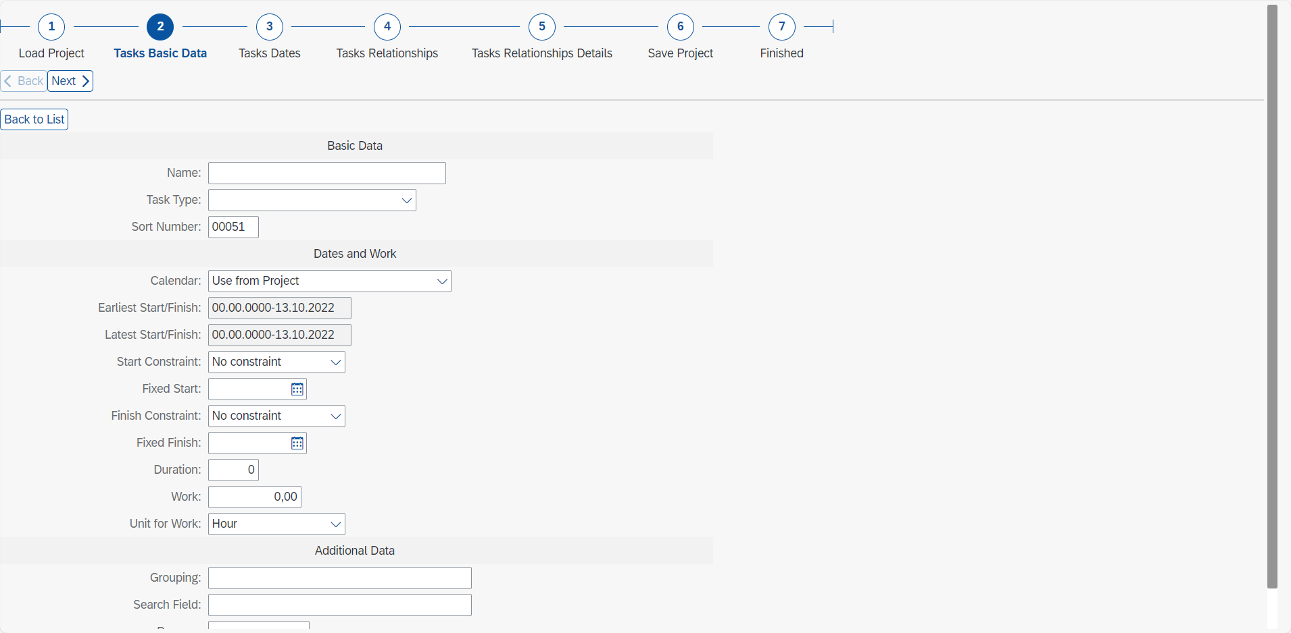
App Task Processing V: Creating a new task
1. Select action Create task/sub-task
2. Input of data for new task

Slide 11
Contact & Sales
We are happy to answer your questions or provide you a non-binding offer directly. Use our licence calculator at www.milliarum.de under Apps or send us the following data to info@milliarum.com:
• Desired edition
• Number of users and developer licences
• SAP release and SAP UI version used
You will receive a software contract from us including maintenance and support.
After signed contract and receipt of payment, the software will be delivered by transport.
Milliarum GmbH & Co.KG
An der Eickesmühle 22
41238 Mönchengladbach
Tel.: +49 (0) 2166 3101 106
www.milliarum.de

