Slide 1
Milliarum App-Collection: PPM Project processing

Slide 2
About Milliarum
• We focus our consulting and development on system solutions for SAP Project Management since the company was founded in 2006
• Our solutions are based on the SAP® Project System and SAP® EPPM
• Our focus is on Project Management, Product Development, customised production and resource management processes
• The aim of our solutions is to create efficient, cost-effective and therefore competitive business processes for our customers
• With the Milliarum Cockpit (MC) and its content packages, as well as the Milliarum Apps we have standardised software products that "close the gaps" in SAP's standard software for Project Management.

Slide 3
Overview of Milliarum Apps
• Standardised UI5 or Web Dynpro apps "for quick usage„
• "Modern" and simple User Interface
• Can be used immediately due to preconfigured scope of delivery
• Access via Fiori Launchpad/SAP Business Client/URL
• Runs with PPM 6.1/ERP EHP8 and SAP_UI 7.54 or higher and for all S/4HANA releases
• Delivery as transport
• Language versions: German and English
• Licence model with maintenance/support (17% annually)
• Customised expansion options
• Interface customisation as part of the SAP infrastructure (SAP UI5 flexibility, Web Dynpro configuration)
• Marketing/Sales via Milliarum website (Apps area)
• Ticket system for customer reports via Mantis

Slide 4
Milliarum App Collection overview
• Collect/bundle individual apps into one topic area
• Can be used immediately through pre-configured scope of delivery (combination of individual apps)
• Price advantage and/or functionality advantages compared to the individual apps
• Price advantage of at least 20% compared to purchasing the individual apps
• No subsequent upgrade option from individual apps to collections due to different software/customising deliveries (upgrade to content package is possible)
• App collections can be automatically expanded with new individual apps as part of the maintenance/support agreement be extended

Slide 5
Demarcation of Milliarum products
Feature/Product | (Single) App | App-Collection | Content-Package
Standardisation | Immediately executable | Ready to start immediately | Customising necessary, best practice partly available
Functional scope | Single function | Collection of single functions | Maximum functionality through customising and extensions must be activated
Additional functions via maintenance contract | For the single function | For the individual function and extension with new single apps | Includes the App Collection plus extension with additional functions
Need consulting | Not required | Not required | Necessary, scope product dependent
Development licences | Available for programming new apps and extending the standard apps | Available for programming new apps and extending the standard apps | Available for programming new apps and extending the standard apps
Target group | Individual user group for specific function | User groups for specific functional areas | Company-wide solution for one topic

Slide 6
Milliarum WebDynpro Apps: General conditions
• Delivery via transport requests (development/customising) based on separate Scenarios/Roles in the Milliarum Cockpit
• Single call as "SingleService" by entering the project number
• Instructions for embedding the App in the PPM project dashboard
• Customising environment for defining the app
• Prerequisite: at least PPM 6.1 or S/4HANA EPPM 1.0
• Licensing via User with a maintenance contract

Slide 7
Overall Resource Management process (with SAP PPM Project and Milliarum Multi-Project Role Planning)
1
Capacity availability
Project ( Project Management)
Cost centre ( Resource Management)
Demand planning and adjustment
Staff scheduling
- PL/Resource Manager checks the requirements and schedules the Employees/Resources
- Allocation according to Roles / Tasks
Project management reports requirement for role "Engineering" from May to June with a budget of 300 hours
Ms. Schulz and Mr. Meier assigned to the notified requirements for the "Engineering " role
PPM Project Management and Milliarum Multi-Project role planning
2
3
Checking hours for adjustment the requirements planning
Time recording and approval
- The project management carries out plausibility checks at" Role/Task level“
- Conspicuous issues are resolved in dialogue
- Ms. Schulz and Mr. Meier report their hours
- PL/Resource Manager approves these
5
4
6
Evaluation/simulation

Slide 8
Functional scope of the Milliarum App Collection PPM Project Management
Consists of single apps:
▪ PPM Project date shift (roles and staffing)
https://www.milliarum.de/apps/terminverschiebung-rollen-und-besetzungen/
▪ PPM Project task processing (dates)
https://www.milliarum.de/apps/ppm-aufgabenbearbeitung-termine/
▪ PPM Project task processing (roles and resources)
https://www.milliarum.de/apps/ppm-aufgabenbearbeitung-rollen-und-ressourcen/
▪ PPM Multi-project planning (roles)
https://www.milliarum.de/apps/ppm-multiprojektrollenplanung/
▪ PPM Task dashboard
https://www.milliarum.de/apps/ppm-aufgabendashboard/
▪ PPM Project system
https://www.milliarum.de/apps/ppm-projektanlage/
Additional functions:
▪ PPM multi-project planning (roles) includes additional access to the individual apps
▪ PPM project status change as an additional individual app

Slide 9
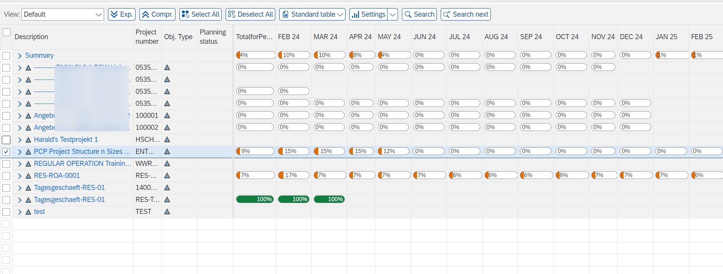
Multi-Project role planning: Jump to single apps
Preconfigured jumps in single apps

Slide 10
PPM Task dashboard
1. Overview screen of all added tiles (one responsive and one desktop version each)

Slide 11
Milliarum Apps: Internet presentation and sales process
• Open on Milliarum website Milliarum - Portfolio, Project and Resource Management with SAP
• Overview page for apps
• Detail page for each individual app with
• Description overview
• Download PDF document with detailed functional description and screenshots
• Short video with function overview
• Technical information
• Price information for licences and maintenance/support via "Configurator„
• Contact form for quotation/contract request
• Sales processing
• The offer will be sent with software contract incl. maintenance/support
• Return signed software contract
• After receipt of payment, software is delivered by transport

Slide 12
Price scale App-Collection "PPM Project Management"
Scale | Content | Extension | Development licences | Price scale
Standard | App-Collection „PPM Projektbearbeitung“ | SAP Standard enhancement | 0 | 15.000€: to 25 Users 30.000€: 26 - 50 Users 45.000€: 51 - 150 Users 60.000€: 151-350 Users 75.000€: 351-750 Users
Professional | App-Collection „PPM Projektbearbeitung“ | SAP standard extension and customised apps based on the Milliarum WebDynpro infrastructure | 1 | 20.000€ : up to 25 users (15.000€ user licence + 5.000€ developer licence*, each additional developer licence 5000€) 35.000€ 26 - 50 users 50.000€ 51 - 150 users 65.000€ 151 - 350 users 80.000€ 351-750 users
Premium | App-Collection „PPM Projektbearbeitung“ + customised adjustments | SAP standard extension and customised apps based on the Milliarum WebDynpro infrastructure | 1 | On request
Maintenance/ Support |  |  |  | 17% per year

Slide 13
Contact & Sales
We are happy to answer your questions or provide you a non-binding offer directly. Use our licence calculator at www.milliarum.com under Apps or send us the following data to info@milliarum.com:
• Desired edition
• Number of users and developer licences
• SAP release and SAP UI version used
You will receive a software contract from us including maintenance and support.
After signed contract and receipt of payment, the software will be delivered by transport.
Milliarum GmbH & Co.KG
An der Eickesmühle 22
41238 Mönchengladbach
Tel.: +49 (0) 2166 3101 106
www.milliarum.de

